Slide 1

Why use Antivirus?
Manu mathews

Slide 2
30% of all targeted cyber attacks are focused on small businesses
Percentage of attacks that targeted small businesses
Percentage of businesses that shutdown within 6 months of a cyber attack
30%

Slide 3

Why we should use antivirus?
Security
Company reputation
Better resource management

Slide 4

Safety
Helps keep sensitive data from leaking.
Keeps hackers from having access to company computers.
Data that belongs to clients stays secure

Slide 5

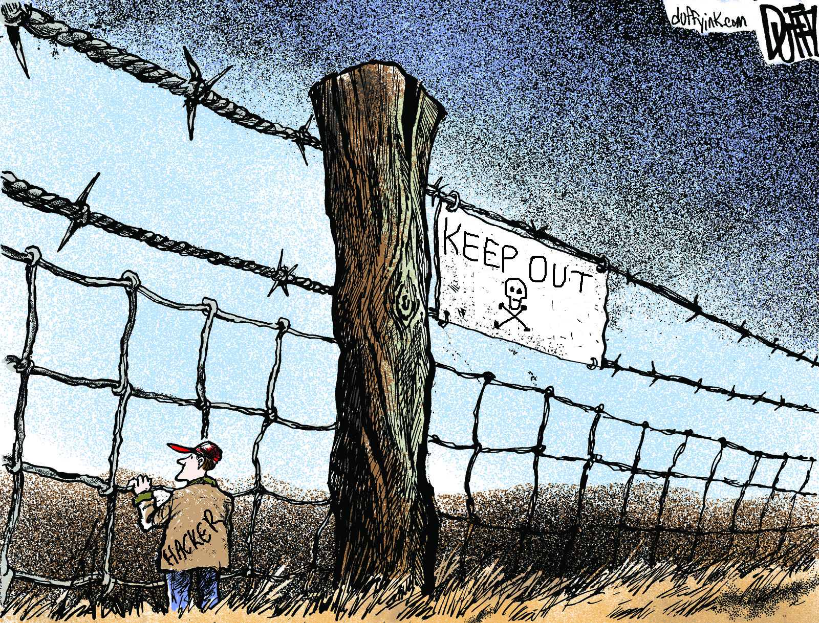
Company Reputation
Clients prefer to work with companies that have good security standards.
It can help set this company apart from other companies that does not have similar security measures

Slide 6

Better Resource Management
An average data breach costs small businesses about $200 per incident, and major data breaches that violate compliance issues can cost companies millions.
It is cheaper to have good antivirus protection than to wait for an
attack and cleaning it up then.
All the computers are on the same network so if one
computer is infected, there is a high chance that other
computers will get infected as well.

Slide 7



Suggested Antivirus?

Slide 8

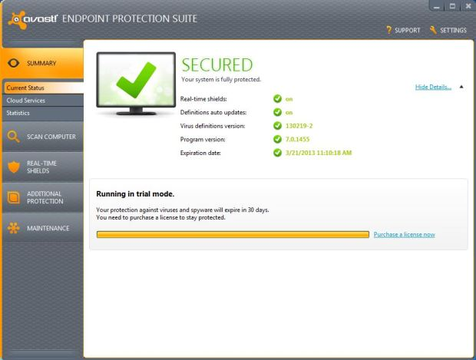
Paid: Avast Endpoint Protection Plus
$1039.80 – 20 PC’s – 3 years
Behavior Shield (keeps an eye on applications while they are running to check for suspicious activities)
Avast Sandbox (Virtual Environment to run applications in a contained area)
Remote Deployment
Built-in firewall
Antispam

Slide 9

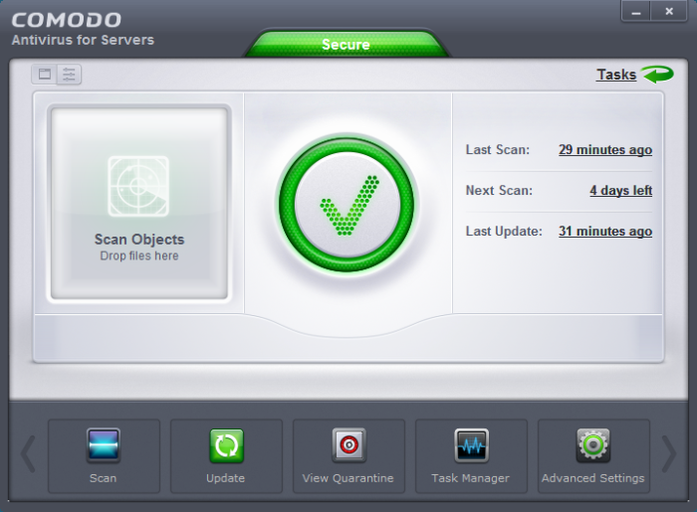
Free: Comodo Antivirus
Auto Sandbox Technology
Full strength, top notch virus detection and elimination
Quarantine system to isolate suspicious files
Cloud based Antivirus
Default Deny Protection™

Slide 10
Sources
Images
www.ipswitchft.com
entreclick.com
www.techprone.com
www.clipart-finder.com
www.community.spiceworks.com
Statistics/other facts.
http://anti-virus-software-review.toptenreviews.com/small-business-antivirus/small-business- targeted-attacks-is-your-company-at-risk-.html
www.symantec.com
http://anti-virus-software-review.toptenreviews.com/bitdefender-review.html?cmpid=rt-mostpop
http://www.pcmag.com/article2/0,2817,2372364,00.asp
http://www.businessnewsdaily.com/2513-antivirus-software-business.html
financefarmer.com
www.comodo.com
www.avast.com

